Slide 1
SECURITY BUDDY
Group 3
Name | ID
Shafin T. Mashfu | 1620255042
Rubayet Zaman | 1620684642

Slide 2



COMPONENTS
Computer
Camera
Microcontroller

Slide 3
Object Tracking
In order to track and count an object in a video stream, we need an easy way to store information regarding the object itself, including:
It’s object ID
It’s previous centroids (so we can easily to compute the direction the object is moving)
Whether or not the object has already been counted

Slide 4
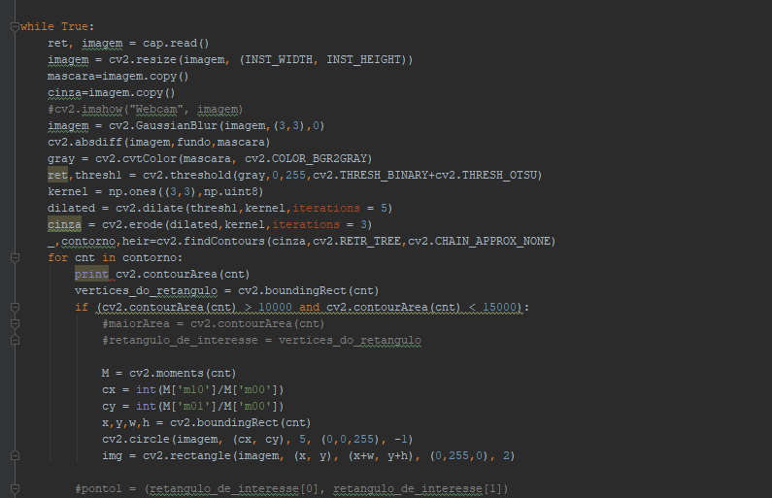
Background Subtractor and Averaging:
Background subtraction (BS) is a common and widely used technique for generating a foreground mask (namely, a binary image containing the pixels belonging to moving objects in the scene) by using static cameras.

Slide 5
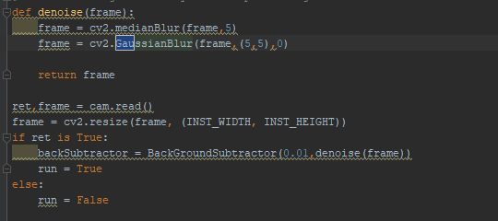
Gaussian Blurring
We specify the width and height of kernel which should be positive and odd. We also should specify the standard deviation in X and Y direction, sigmaX and sigmaY respectively. If only sigmaX is specified, sigmaY is taken as same as sigmaX. If both are given as zeros, they are calculated from kernel size. Gaussian blurring is highly effective in removing gaussian noise from the image.

Slide 6
Motion Tracking
We compare two images by comparing the intensity value of each pixels of two consecutive frames
Gray Area will be introduced.
Using contour Area, the comparison will be made.

Slide 7
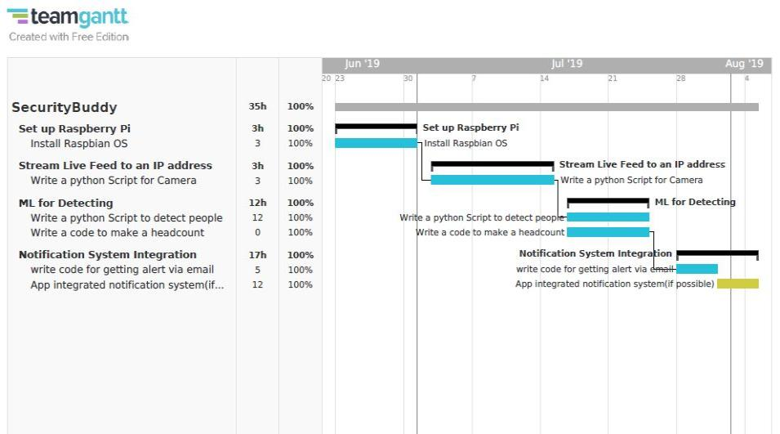
GANTT CHART

Slide 8
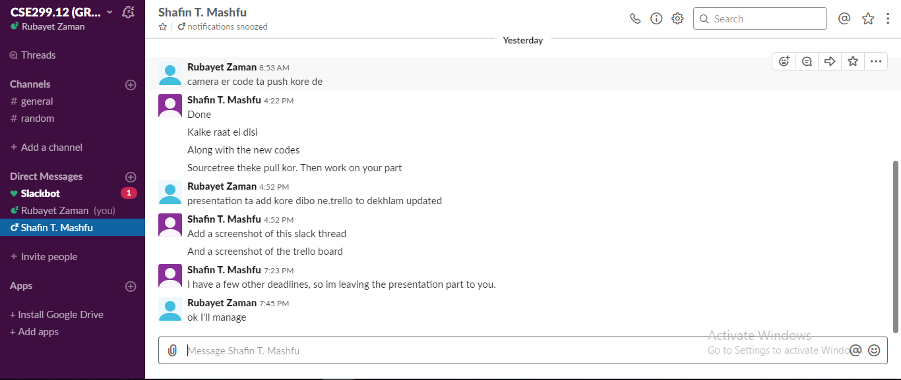
Slack Update

Slide 9
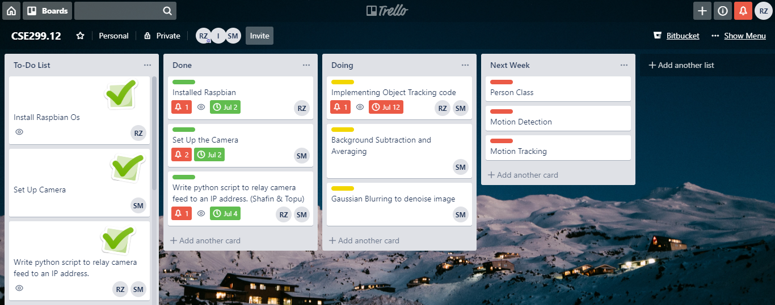
Trello Update

